Slide 1

THOMAS & CO. LIMITED
GLOBALGAP CERTIFIED
ISO 22000 Certified (FSMS)
PLOT 85, CHORLEY CRESCENT ROAD
PORTBELL, LUZIRA
P.O. BOX 36399, KAMPALA, UGANDA
http://www.tandcafrica.com/
+256 706 706 706
tandckampala@gmail.com
https://goo.gl/maps/VwUm2bGHqeC2

Slide 2

Company Profile
Thomas and Company Ltd or T & C Ltd was incorporated in the year 2004, with its headquarters located in Kampala, Uganda. The main objective being un-tapping the immense trading opportunities available in Uganda, the PEARL OF AFRICA.
The company first started supplying Fresh Fruits,Vegetables and other dry rations in the year 2000, to the UNITED NATIONS Mission in Congo and Sudan. Over the year, due to the company's dedicated and committed services, the company was asked to supply to their warehouses in Bunia, Beni, Aru, Mahagi, Bukavu, Goma (Democratic Republic of Congo), Juba and Wau (Southern Sudan), Abeyi (sudan), Central African Republic
The Company procures most of its items from Local market thereby playing an active role in uplifting the living conditions of the local citizens by providing adequate job opportunities and ready available markets for locally produced goods.
With the team of committed and dedicated staff, the company aims to achieve and scale greater heights and become an important player in the field of exporting, not only in local market but also in the regional as well as continental level.

Slide 3
COMPANY FOOD SAFETY POLICY
(ISO 22000 - 2018) & GLOBAL GAP CERTIFIED
Thomas and Co. Ltd believes that success depends on the supply of high quality products and services that meet and exceed customer and consumer expectations. Fundamental to this believe is the safety of all products that are supplied.
Thomas and Co. Ltd is committed to continually enhance the reputation of the products and services it supplies and to maintain consumer confidence in its products through the development and implementation of quality and food safety systems, and meeting all the applicable statutory, regulatory and contractual requirements. We also commit to continuous improvement and shall ensure periodic measurement, evaluation and validation of the food safety system.
At Thomas and Co. Ltd we believe that the responsibility for achieving quality and food safety lies with each of the employees as they execute their jobs and responsibilities especially those that have direct influence on processing, supplying, storage and the delivering of products. Therefore, management is committed to ensure that all employees are given the relevant training to ensure production of safe products.
This policy shall be reviewed annually or as need arises due to any changes in the system and shall be communicated to all stakeholders. (Clients, Suppliers and Employees)

Slide 4
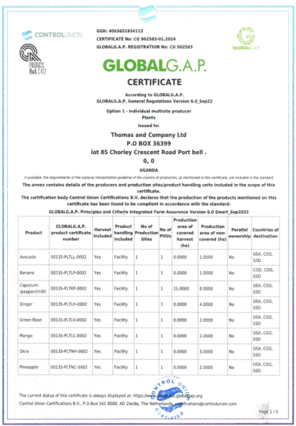
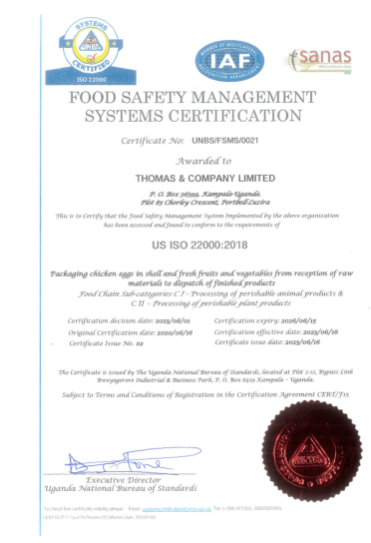
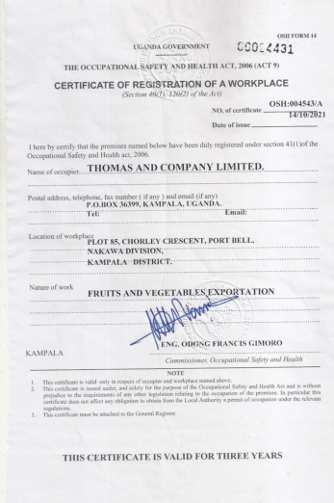
QUALITY CERTIFICATE
GLOBALGAP
ISO 22000-2018
REGISTRATION OF WORK PLACE

Slide 5
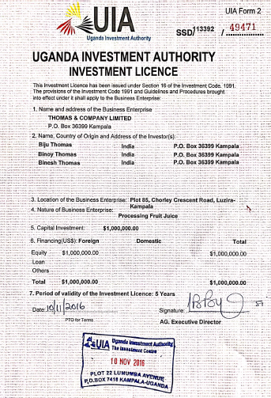
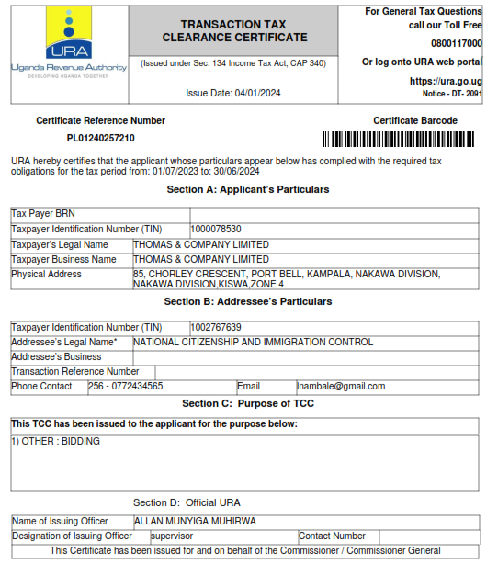
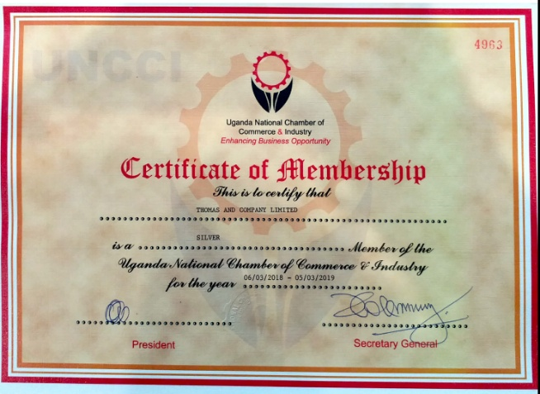
Other certificates / licenses
INVESTMENT AUTHORITY
TAX CLEARANCE CERTIFICATE
UGANDA NATIONAL CHAMBER OF COMMERCE

Slide 6
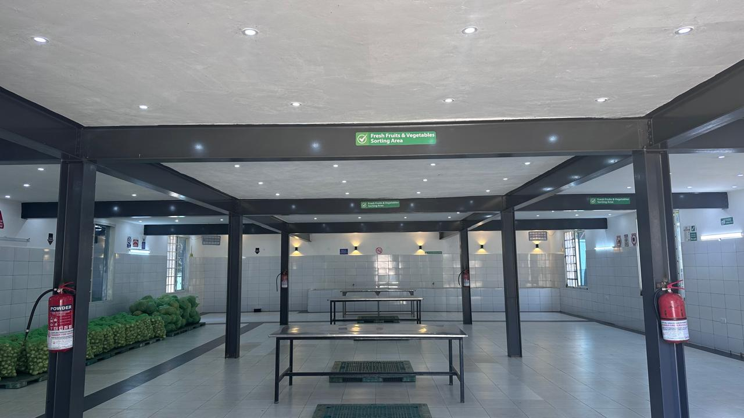
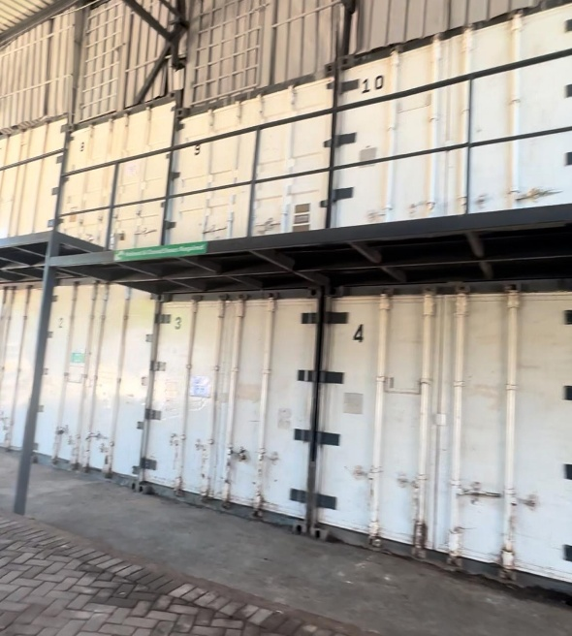
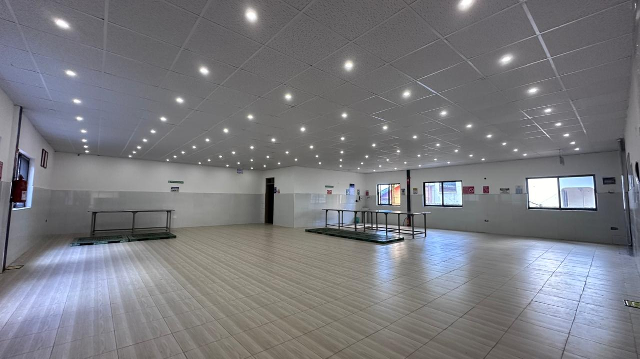
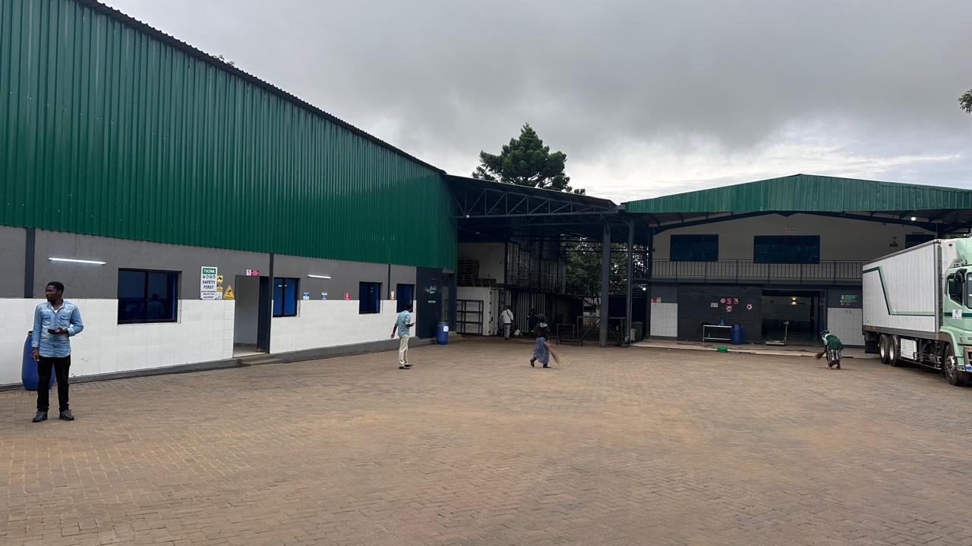
WAREHOUSE

Slide 7
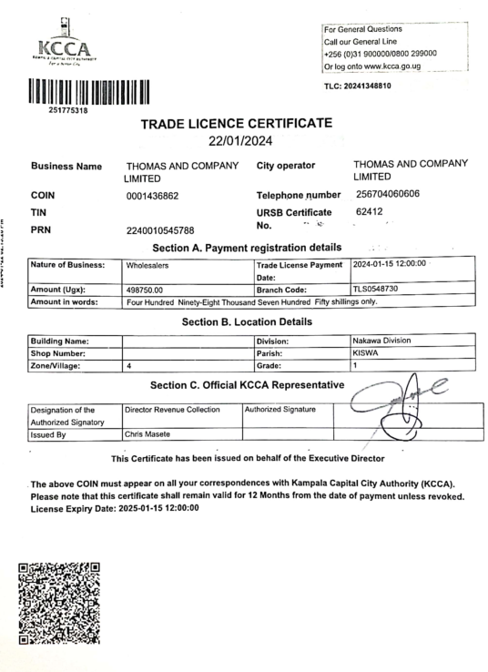
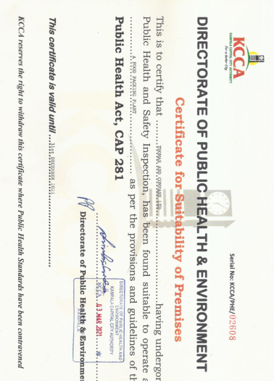
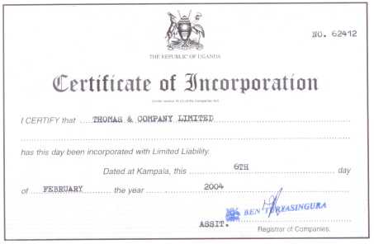
TRADING LIC.
SUITABILITY CERTIFICATE
CERTIFICATE OF INCORPORATION

Slide 8
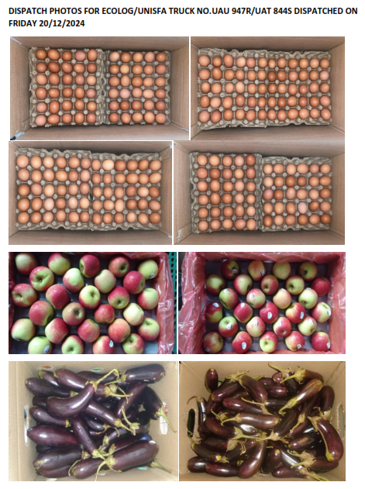
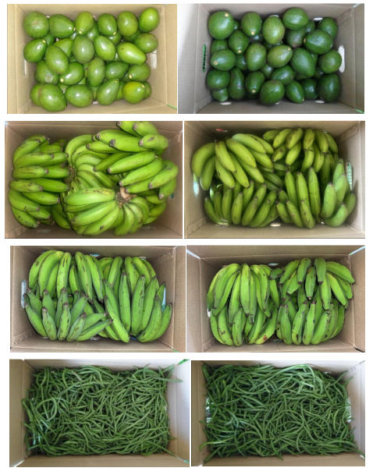
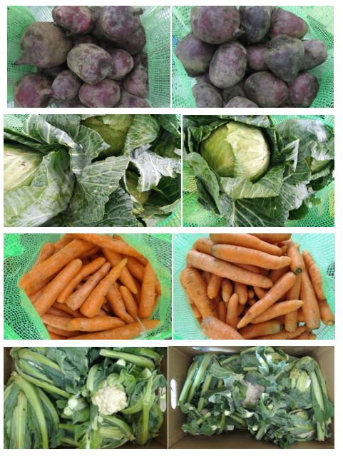
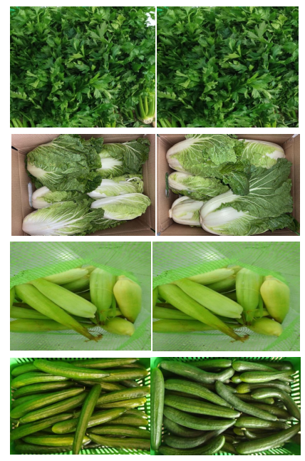
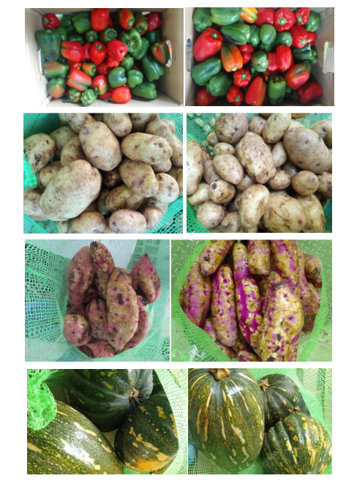
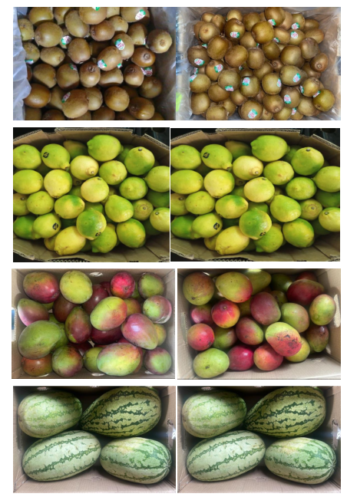
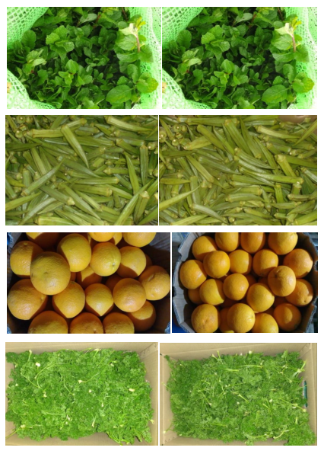
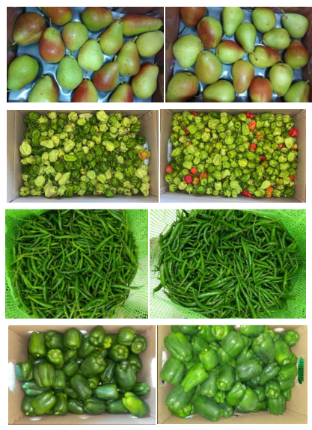
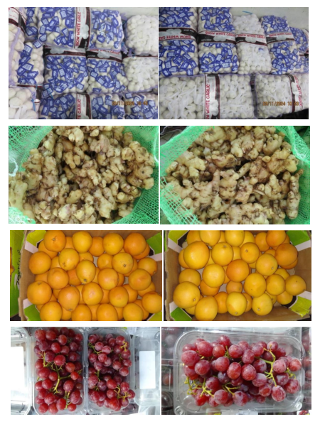
PRODUCTS/PACKAGING

Slide 9
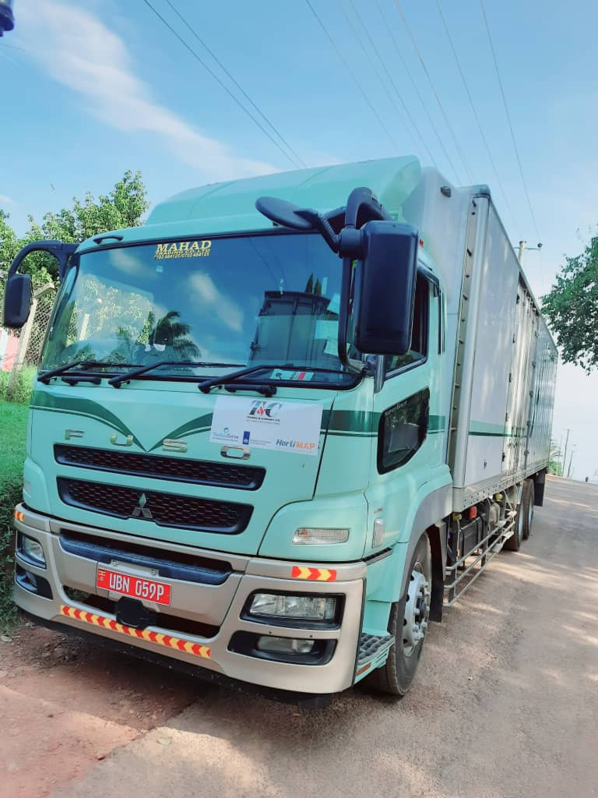
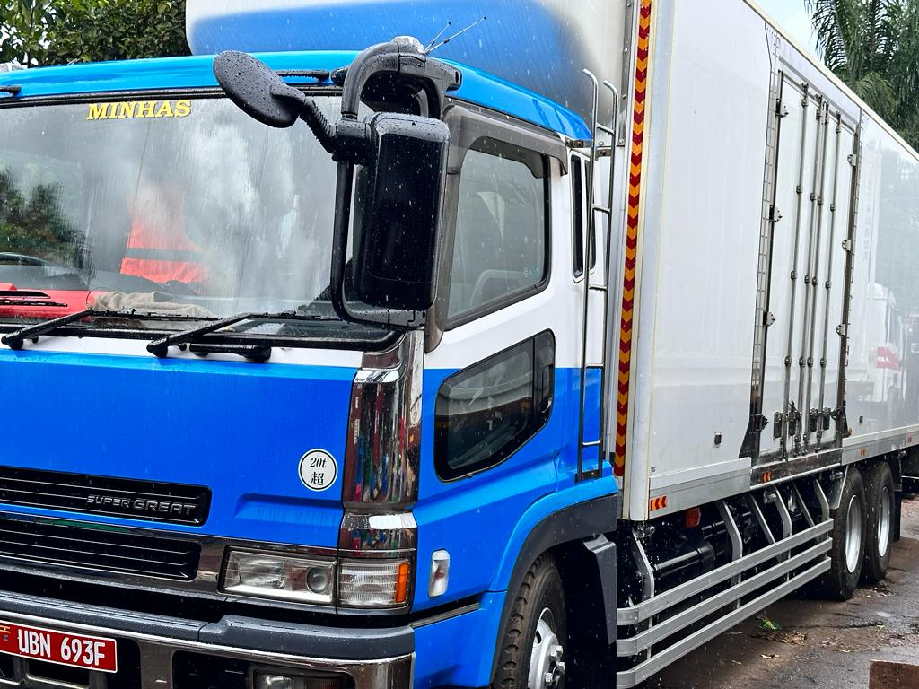
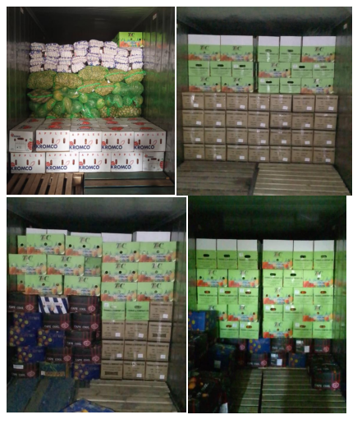
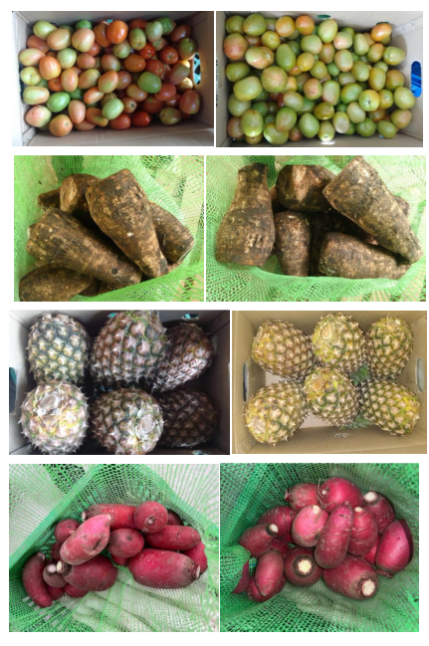
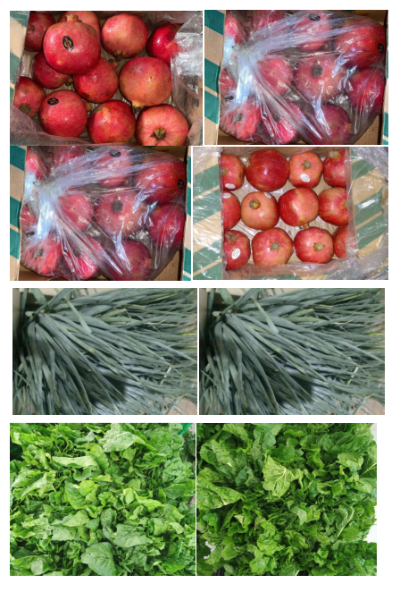
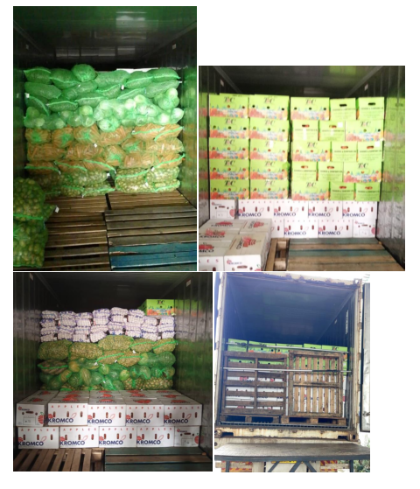
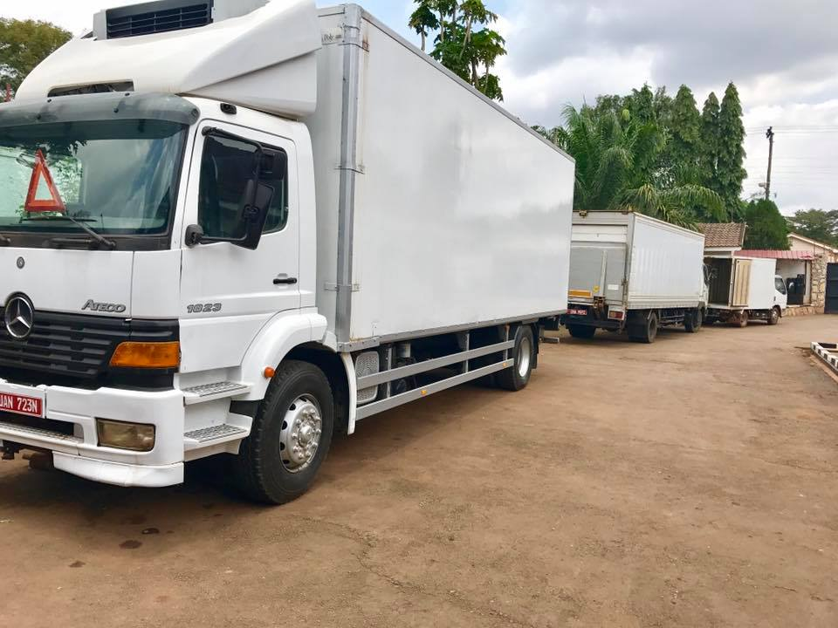
LOADING /PRODUCTS/VEHICLES

Slide 10
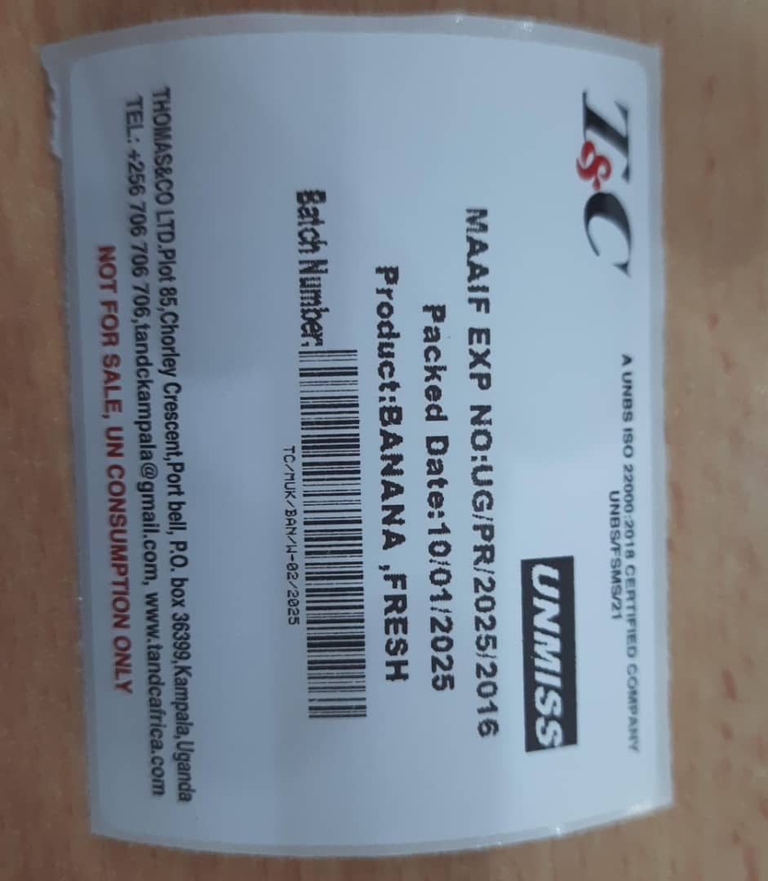
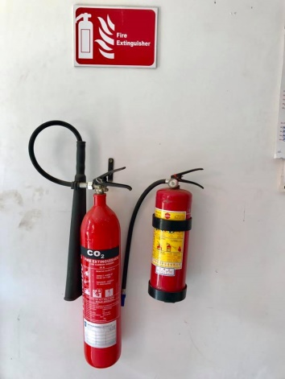
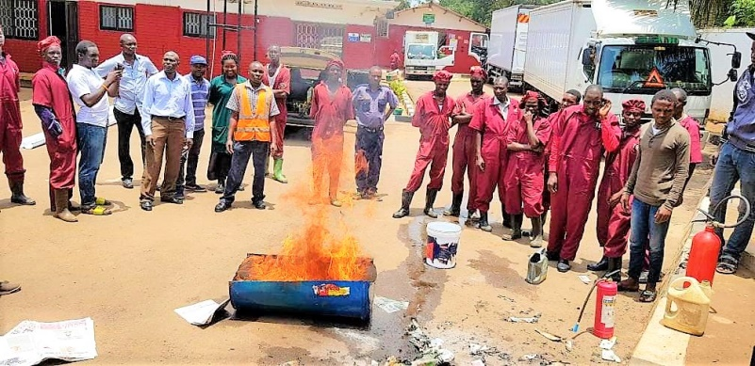
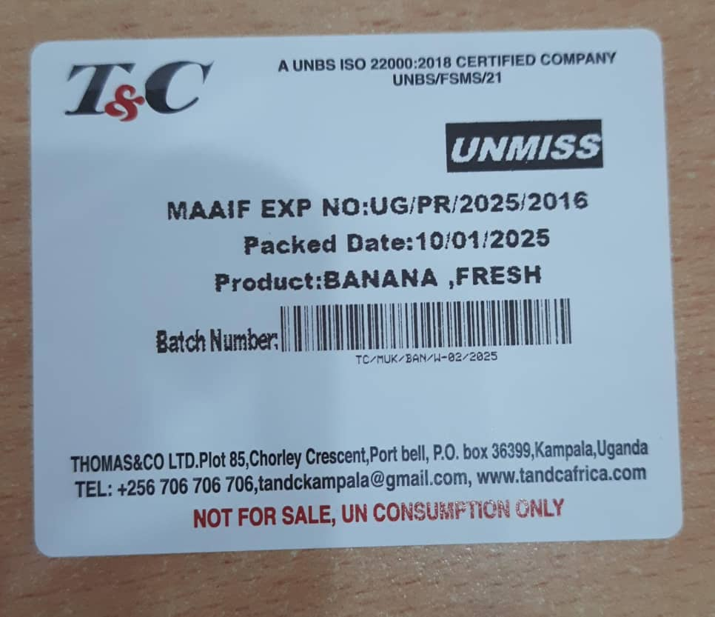
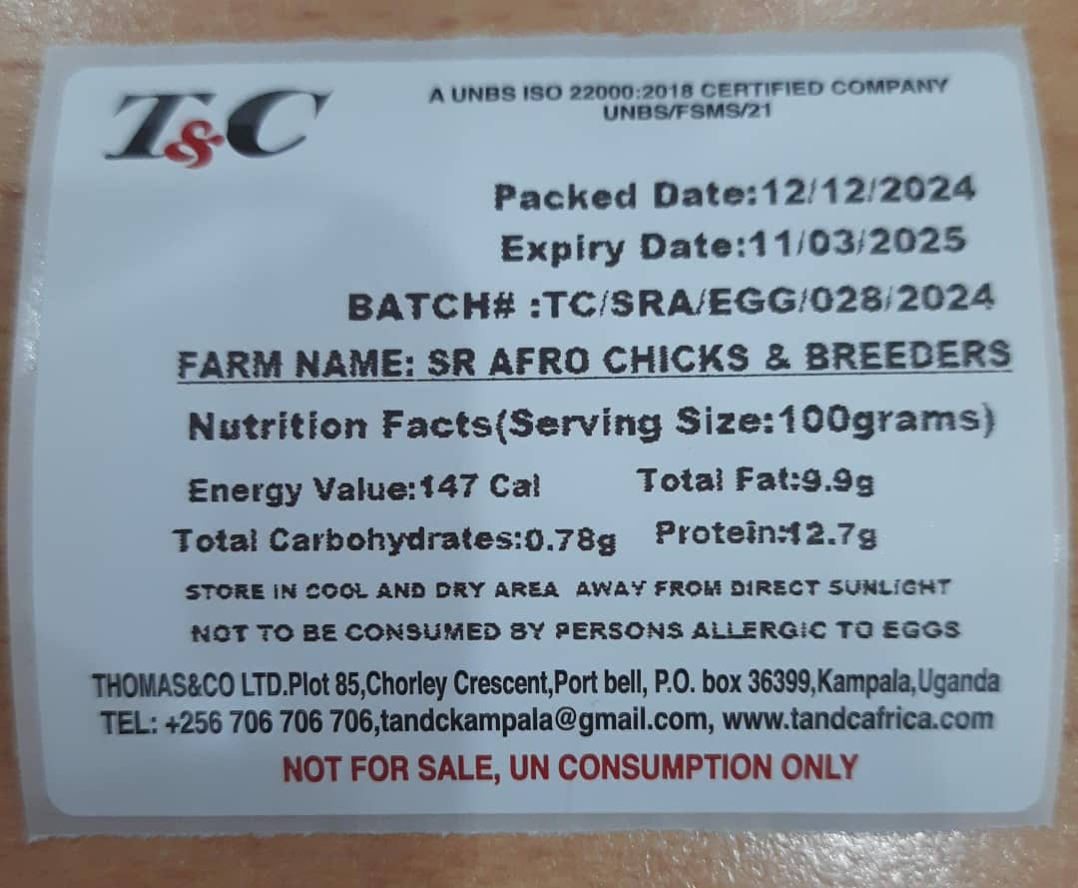
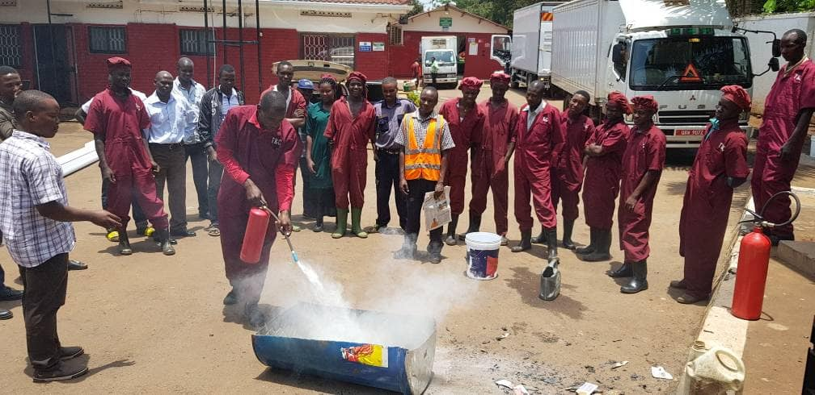
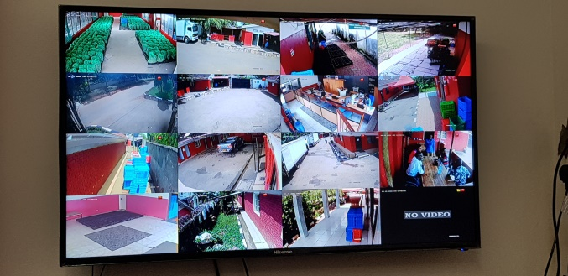
TRACABILITY / SAFETY

Slide 11
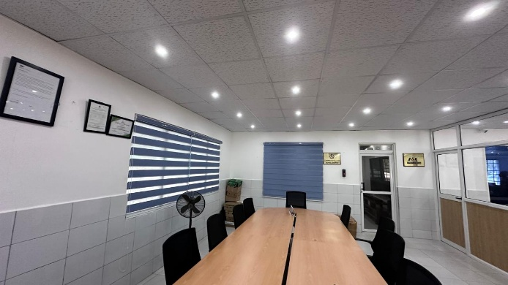
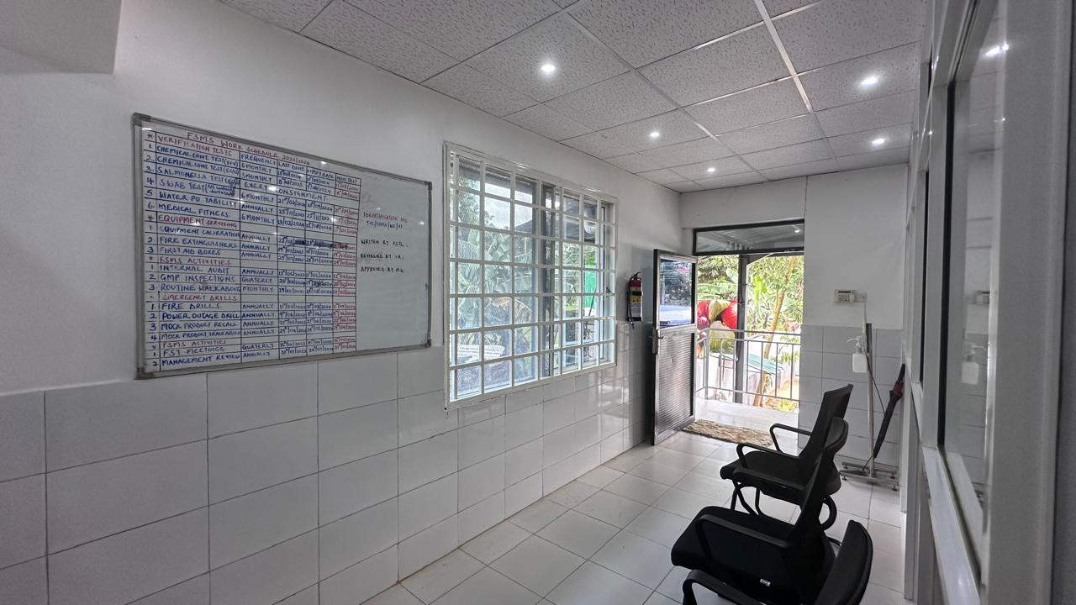
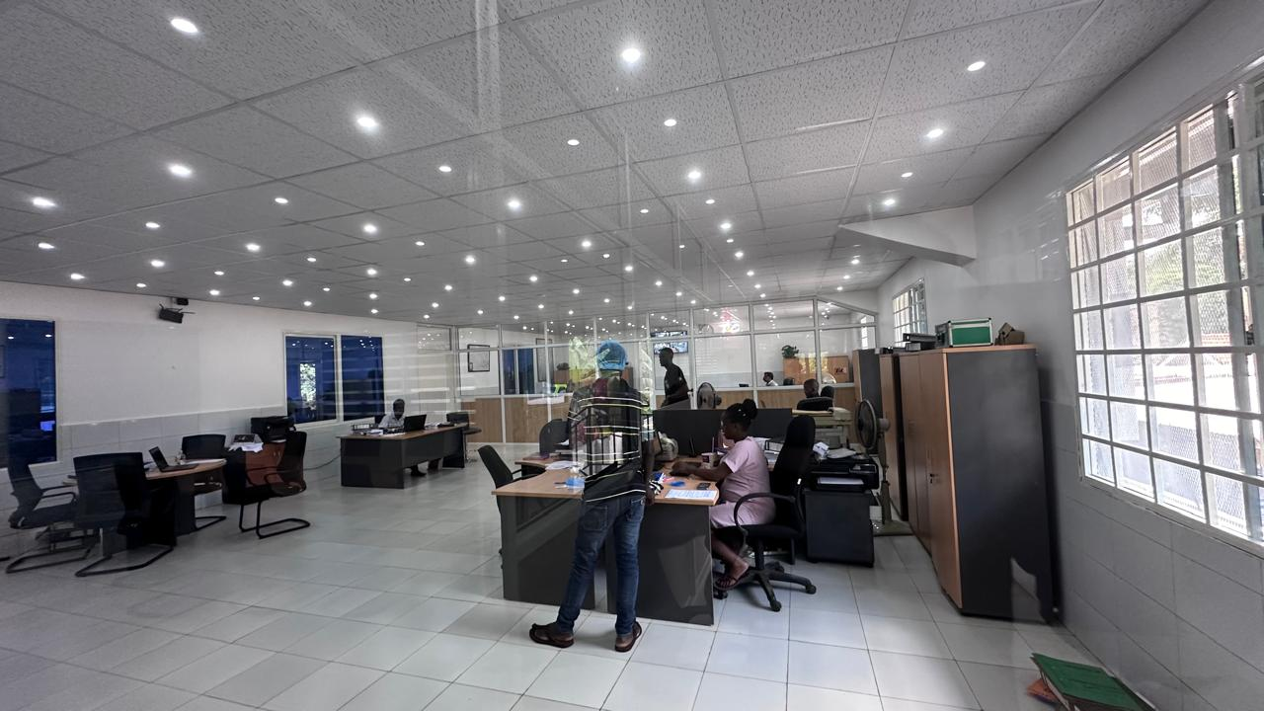


OFFICE

Slide 12
OTHER FACILITIES
EASY ACCESS FOR TRUCKS AND 40”TRAILORS
FULLY TARMAC ACCESS
BACKUP GENERATORS 60KVA
WATER BACKUP
24 HOURS SECURITY WITH CCTV
ELECTRIC FENCE
ROOFED SPACE FOR REFRIGERATED CONTAINERS

